Slide 1
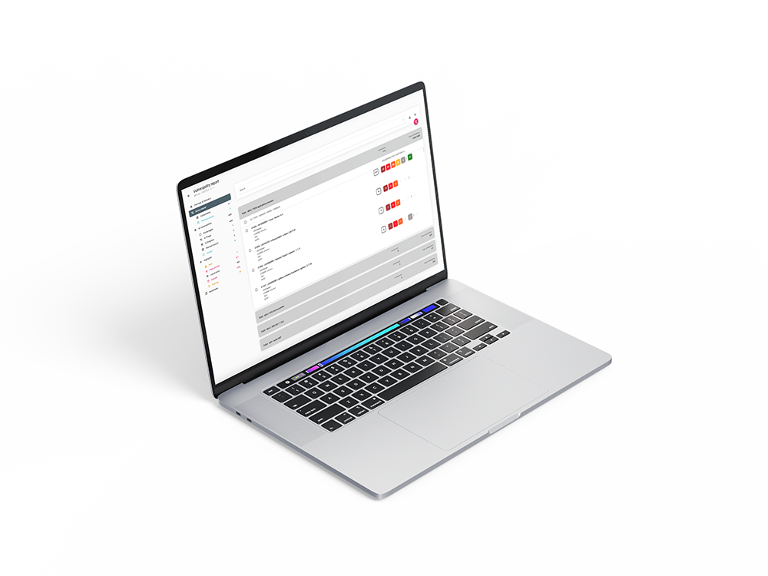

Get grip on product security with ARIANNA
HBOM & SBOM creation | Vulnerability monitoring | Vulnerability management
ARIANNA is a product by

Slide 2
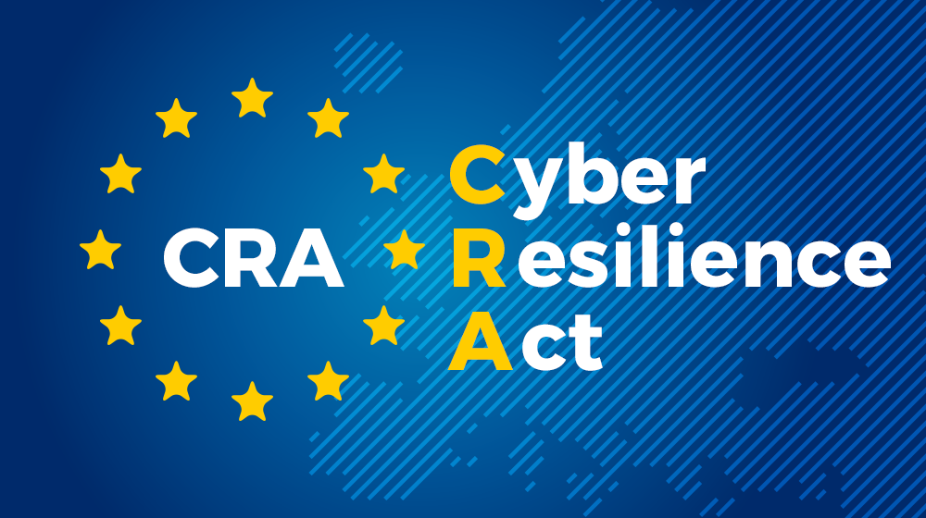
Why Manufacturers Struggle with CRA
CRA requires continuous vulnerability management throughout the product lifecycle.
Manufacturers must maintain SBOMs, monitor vulnerabilities, assess risk and address vulnerabilities.
Many organizations have the components but lack an operational process.

Slide 3
Why ARIANNA exists
Connected products combine hardware and software with long support lifecycles.
Manual vulnerability tracking does not scale.
ARIANNA provides HBOM + SBOM visibility, monitoring, prioritization and reporting in one platform.

Slide 4
From 2,775 Vulnerabilities to 10 Actions
A typical connected device may contain thousands of known vulnerabilities.
CVSS-only prioritization can result in hundreds of vulnerabilities requiring review.
ARIANNA prioritizes based on exploitability and context, reducing the focus to the vulnerabilities that matter most.

Slide 5
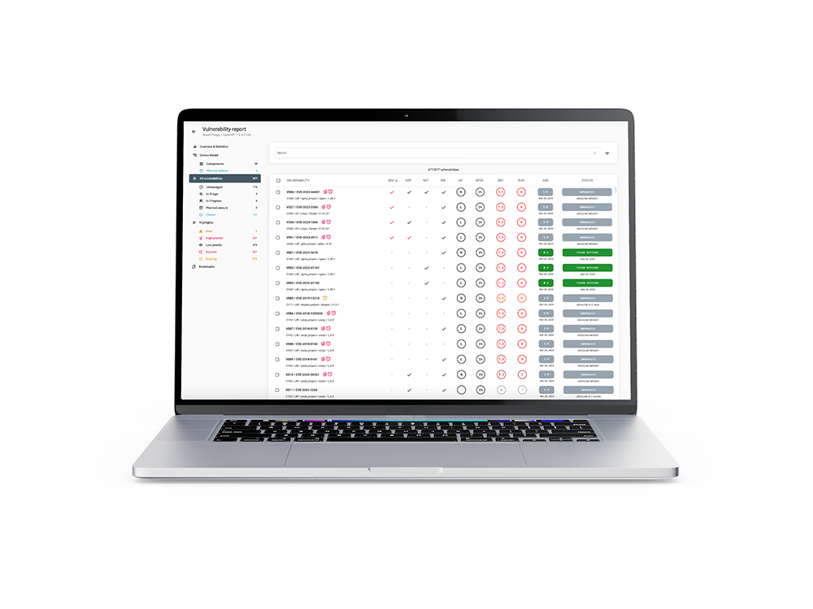
What ARIANNA does
ARIANNA helps device manufacturers run an efficient vulnerability management process.
Device model management (HBOM + SBOM)
Continuous vulnerability monitoring
Risk-based vulnerability management
Reporting for customers and regulatory bodies

Slide 6
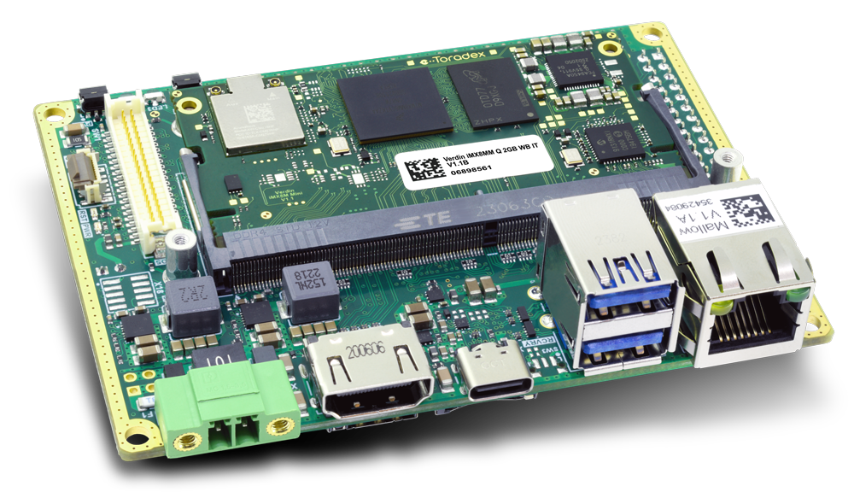
Smart devices are not just software
Hardware Components
MCUs | MPUs | Memories
WiFi, BLE, radio modules | Secure Elements | TPM
Vulnerability management for devices is incomplete without the hardware model.
Hardware components manage critical assets.
Hardware components have vulnerabilities.
They are not exposed to attackers in the same way as software.
The hardware model helps exclude non-reachable software vulnerabilities.
WIFI MODULE
MAIN MPU
MEMORY
MCU
Notes:
In traditional IT systems we think mainly about software vulnerabilities. But smart connected devices are different. They include multiple hardware components, secure elements, and third-party modules. Some vulnerabilities exist in hardware, and many critical assets are managed directly by hardware components. So without a model that includes hardware, vulnerability management for devices is incomplete.

Slide 7
Device Model creation: HBOM
User must identify HW building blocks inside the device
Each hardware building block is named Processing Unit (PU)
PU examples: MCU, MPU, Secure Elements, Memories, WIFI/BLE Modules
For each PU, ARIANNA defines the HBOM according to the HW part number
PU3|ESP32
PU1 | i.MX 93
PU4 | MEMORY
PU2 | STM32F4

Slide 8
Device Model creation: SBOM
For each Processing Unit (PU), ARIANNA supports the creation of the SBOM.
A PU SBOM can combine multiple SBOMs.
MPUs can include an OS SBOM plus SBOMs for customer applications.
MCUs can include a bootloader SBOM plus a firmware SBOM.
Components in the final SBOM are grouped accordingly.
Each SBOM is created with support from a dedicated ARIANNA SCA tool.
Javascript Application
SBOM
Python Application
SBOM
YOCTO SBOM
Bootloader SBOM
Firmware SBOM
Firmware SBOM
PU1 | i.MX 93
PU2 | STM32F4
PU3 | ESP32

Slide 9
Device Model lifecycle & VMP
The device model evolves throughout the product lifecycle.
HBOM usually stays constant.
SBOM should be updated whenever a new firmware or software release is made.
When a new device model version is created, new vulnerabilities may appear.
Existing vulnerabilities can remain open or close automatically if affected components are updated or removed.

Slide 10
Continuous Vulnerability Monitoring
ARIANNA identifies new vulnerabilities daily for every monitored device based on its device model.
It uses an internal mapping between hardware/software components and known vulnerabilities.
Public sources such as NVD, CVE.org, GitHub Advisories, and EUVD are monitored continuously.
ARIANNA enriches findings with exploit evidence, KEV status, EPSS, exploit maturity, and CWE information.

Slide 11
Severity alone is no longer enough
CVSS is not sufficient for prioritization
CVSS useful to measure the potential risk
Context matters more than Severity Score
A vulnerability in a component that is not exposed to the network is very different from the same vulnerability in an internet-facing device.
Exploitability matters more than quantity
Fixing 50 theoretical vulnerabilities does not improve security as much as fixing 5 vulnerabilities that can really be exploited.
Notes:
Today most vulnerability management processes are based mainly on severity scores like CVSS. And CVSS is absolutely useful — it gives us a standard way to measure how dangerous a vulnerability could be.
The problem is that severity does not tell us how dangerous a vulnerability is for our specific device.
We are measuring vulnerabilities correctly, but we are prioritizing them incorrectly.
Smart connected devices have different risks than IT systems
Most scoring systems were created for IT environments. But smart connected devices have firmware, hardware dependencies, and very different attack surfaces.

Slide 12
Configurable pre-triage engine
ARIANNA provides a configurable pre-triage engine
It splits identified vulnerabilities in two classes
High Priority: immediate TRIAGE required
Low Priority: risk ACCEPTED (vulnerability management is postponed)
Reduce triage effort by prioritizing vulnerability management activities
No automatic actions are taken

Slide 13
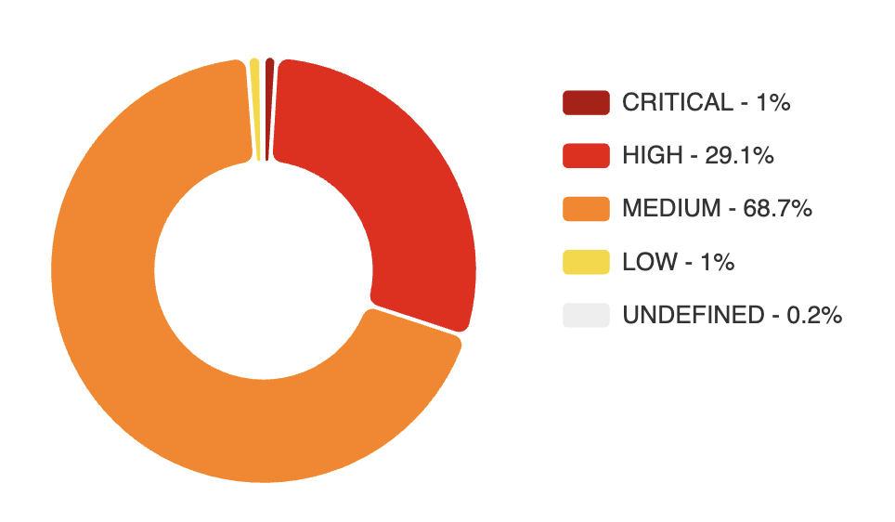
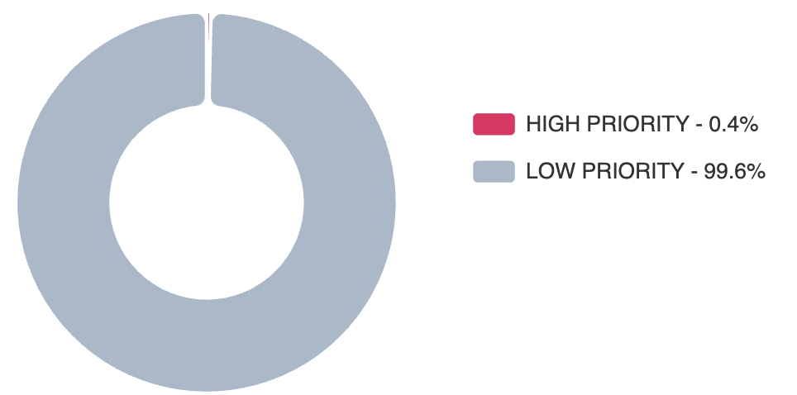
YOCTO Connected Device
2775 identified vulnerabilities
Prioritization based on Severity
CVSS Score > 7.0 (Critical & High)
834 vulnerabilities to triage ASAP (1% + 29.1%)
Prioritization based on Exploitability
Proof of Exploitation or Weaponized exploit
Attack Vector reachable by an attacker
10 vulnerabilities to triage ASAP (0.4%)
Notes:
Left side:
200 vulnerabilities panic random fixing delayed release
Right side:
Context analysis real risk identified focused remediation faster certification

Slide 14
ARIANNA KEV catalogue
ARIANNA KEV focuses on vulnerabilities with evidence of exploitation.
It includes vulnerabilities from the CISA KEV catalogue.
It also includes proof-of-exploitation signals from EUVD and verified or weaponized exploits detected by ARIANNA.
This provides broader and faster coverage than relying on CISA KEV alone.
Result: faster prioritization and remediation.

Slide 15
Reports for customers & regulatory bodies
SBOM (and HBOM) export
Standard formats (CycloneDX or SPDX)
NTIA Minimum Requirements satisfied
Possibility to exclude components from the exported SBOM
Vulnerability Report export
Report on-demand (PDF or VEX format)
Automatic monthly report (PDF format)
All actions taken on vulnerabilities are logged
Notification date, Closure date, Status change dates

Slide 16


Collaboration among teams in ARIANNA
Different teams can manage their own projects in ARIANNA while sharing visibility where needed.
A system-level team can reuse vulnerability decisions already made by component teams.
This reduces duplicated triage effort and improves consistency across products.
VULNs
STATUS
PROJECT A
SBOM & HBOM
TEAM A
VULNs
STATUS
PROJECT B
SBOM & HBOM
TEAM B

Slide 17
Demo walkthrough
Connected device with 3 processing units:
PU1: i.MX93 MPU with Yocto + JavaScript + Python applications
PU2: STM32F4 MCU with bootloader + application firmware
PU3: ESP32 MCU with application firmware
Two device model versions: 1.0 initial model, 2.0 updated ESP32 firmware
Demo focus:
Compare model 1.0 vs 2.0
See new and automatically closed vulnerabilities
Review high-priority vulnerabilities
Export the final report
PU3|ESP32
PU1 | i.MX 93
PU2 | STM32F4

Slide 18
Thank You!

